Slide 1
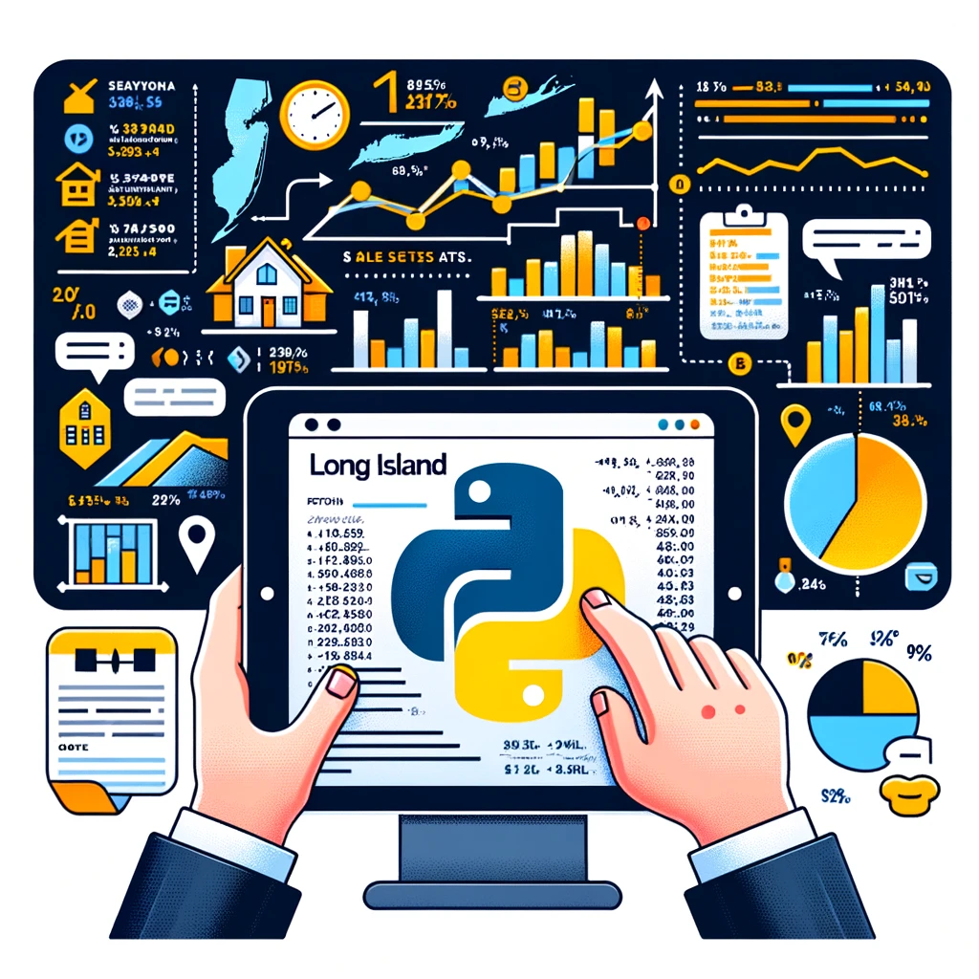
Long Island Real Estate History
Sonia
Fernando Hernandez
Obtaining and investigating purchases on Long Island
Challenges:
Data Retrieval, Cleanup, Presentation
Regression Analysis

Slide 2




Data Review / Cleanup
Zillow: ZTRAX Database
Zillow ended this resource and purged all data relating to ZTRAX
Any pockets of datasets that refer to this charge a premium.
Redfin: Median Monthly Sales
Provided a nearly cleaned dataset to parse.
Info on how fast houses leave market.
CFPB: Loans based on Applicant
Goes over race, ethnicity, age, and whether loan was approved.
Very, very large (5GB) datasets
Freddie Mac: Average Interest Rates, loans processed
Has the most granular info about loans processed
Split into yearly datasets.
Columns are not directly referenced, needed to parse documentation and provide them
Difficult to identify patterns without parsing several years data, and 2020-2022 appear to be an outlier
Roper
Public Opinion datasets
Can be good to gauge what to use prediction models for, but probably not this current project.

Slide 3
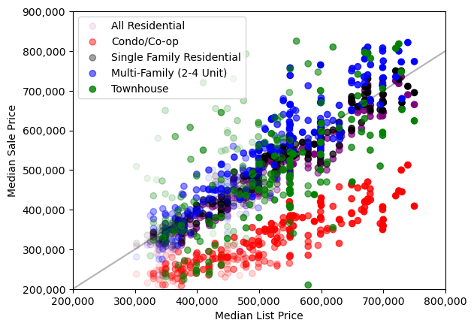
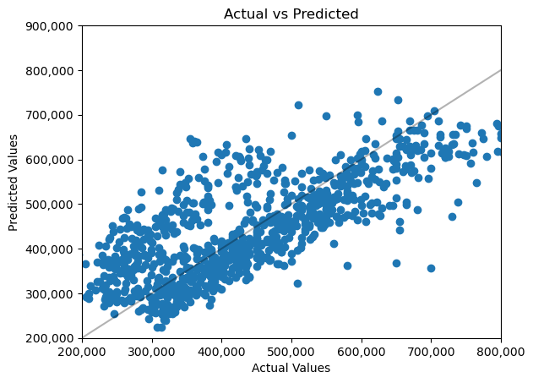
Prospects
Pattern Review:
Using provided datasets to display human-readable charts showcasing how the market’s been trending
Prediction Models:
Attempting Linear Regression to create a prediction model for prices dependent on interest rate and timeframe
Potential: Classification of home type based off loan data.

